Slide 1
SAVEETHA SCHOOL OF ENGINEERING
SIMATS
CSA0819 - Python Programming for Data and Web Analytics MINI PROJECT - JAN 2024
Bank Management project in Python using Tkinter
Presented by:
192210521 – AKHILESH PK SHIVA
192210073 – PRAKUL S
192221020 - CK SHAWN BASIL
Guided by:
Dr. Senthil Kumar

Slide 2
Abstract
Bank management system is a straightforward GUI based program that is simple to grasp and utilize. The GUI is created with Tkinter package. When it comes to the application, users may register an account and login to manage their bank accounts

Slide 3
Introduction
In this project, the Bank management system using Tkinter, The admin can create, update or delete records from the database by logging in using admin login credentials. The user can create an account by entering information such as his / her username, opening balance and pin number, etc. The user must then submit those data in order to gain access to their account. The admin can see transaction information, create new user accounts, create new admin accounts, check information about customers. The user can credit or debit sums by merely specifying a specific amount

Slide 4
Software Requirements
Python IDLE – 3.5 or higher
Tkinter module
Windows 10 or higher

Slide 5
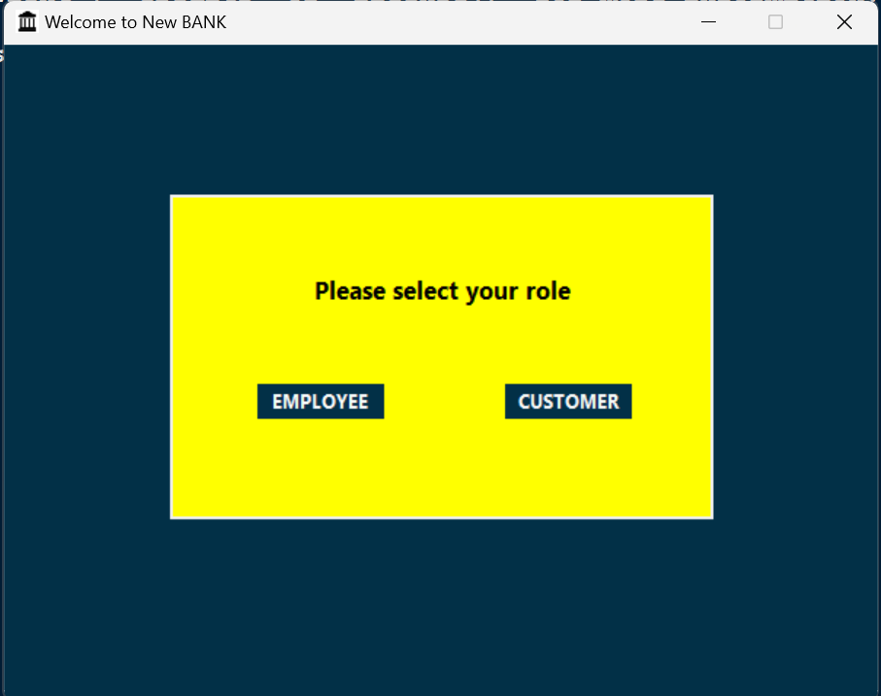
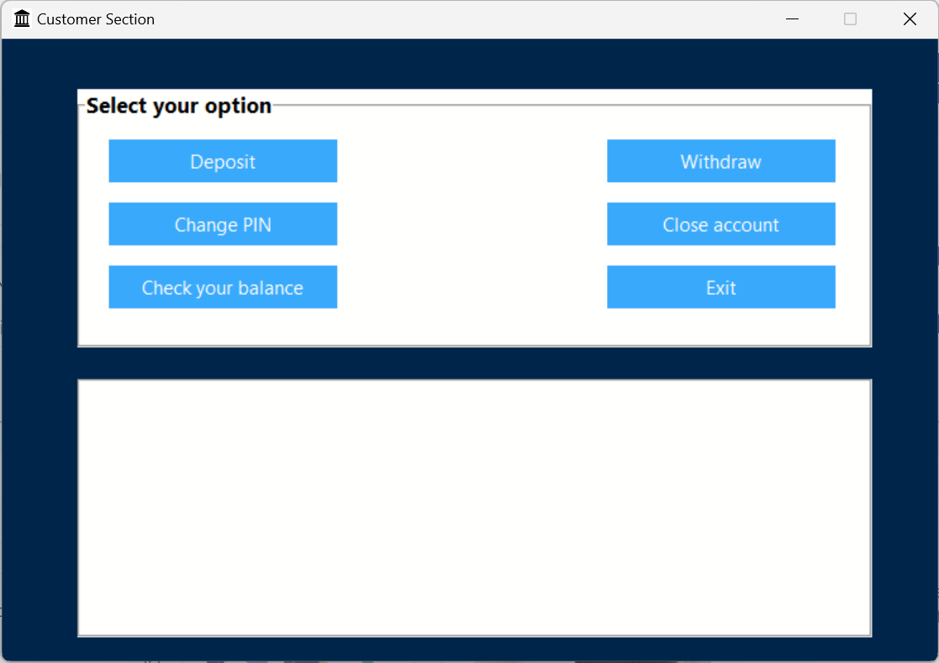
Login Screen
The login screen is the entry point for users to access the bank management system. It provides a secure and user-friendly interface for users to enter their login credentials and authenticate their identity
Dashboard Screen
The dashboard screen is the main interface for users after logging in. It displays relevant information and provides access to various functionalities of the bank management system, such as account management, transaction history, and customer support.

Slide 6
Bank management system files
File | Description
Customers | Stores customer information like Name, DOB, Account number, Account type, Balance, Nationality etc.
Accounts | Tracks account details like account number, Balance, Minimum balance, Customer name and mobile number
Transactions | Records all financial transactions, including deposits, withdrawals, transfers, and payments
Employees | Manages employee data like employee id, name and passwords, access privileges etc.

Slide 7
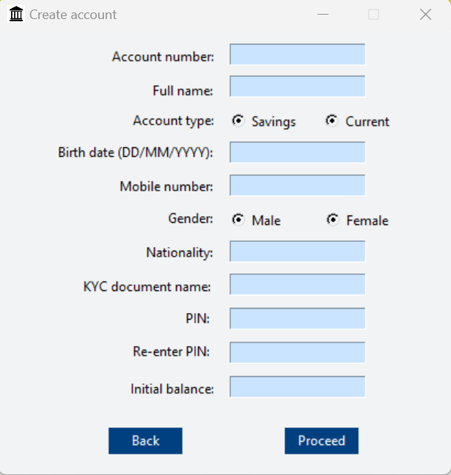
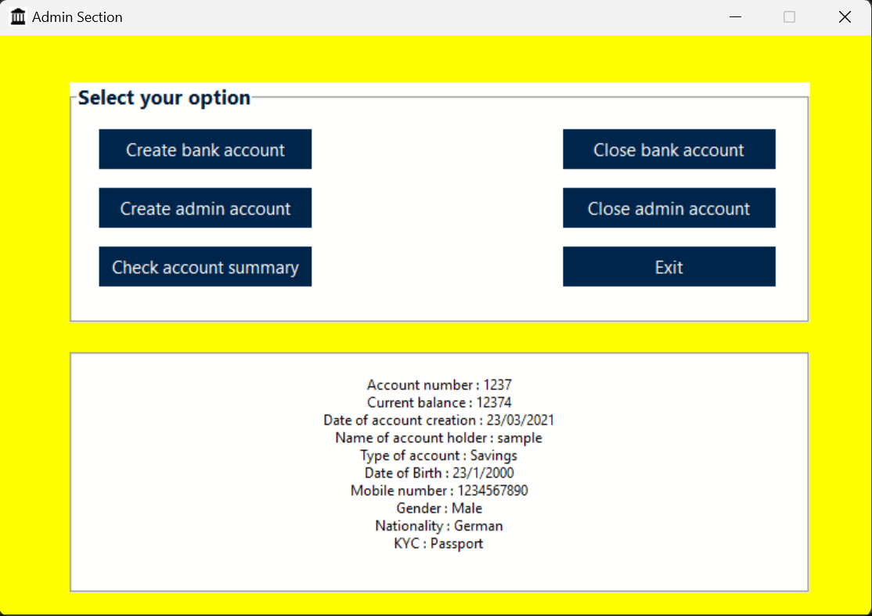
Account Management
Creating Customer Accounts
Our bank management system allows bank employees to easily create customer accounts.
Managing Customer Accounts
With our system, bank employees can efficiently manage customer accounts, including updating customer information, depositing and withdrawing funds, and transferring funds between accounts.

Slide 8
Transactions
Functions | Description
Deposit | Allows users to add funds in their accounts by depositing cash
Withdrawal | Enables users to withdraw cash from their accounts
Checking | Allows users to check their transaction details, balance easily
The bank management system provides robust transaction management capabilities, allowing users to perform various financial operations conveniently and securely.

Slide 9
Screenshots
Login page

Slide 10
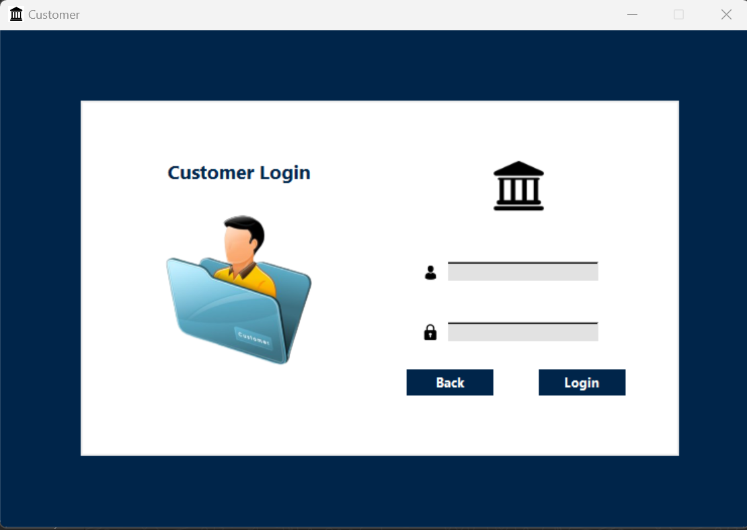
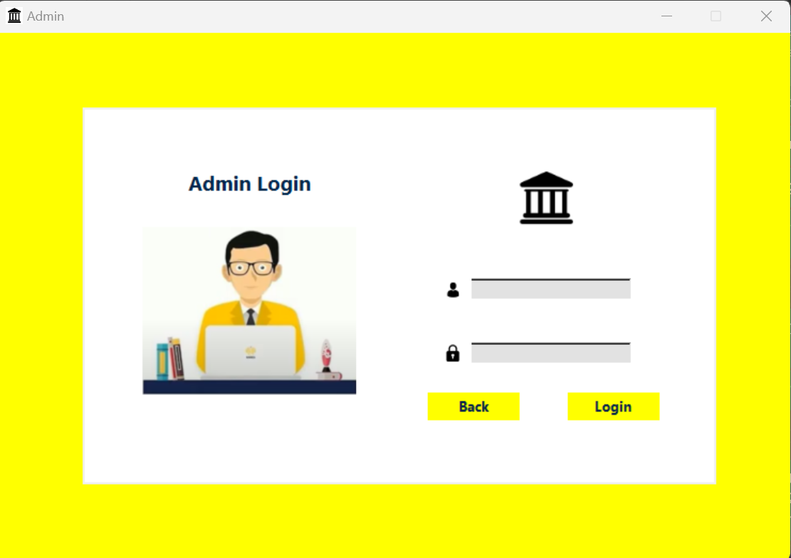

Slide 11
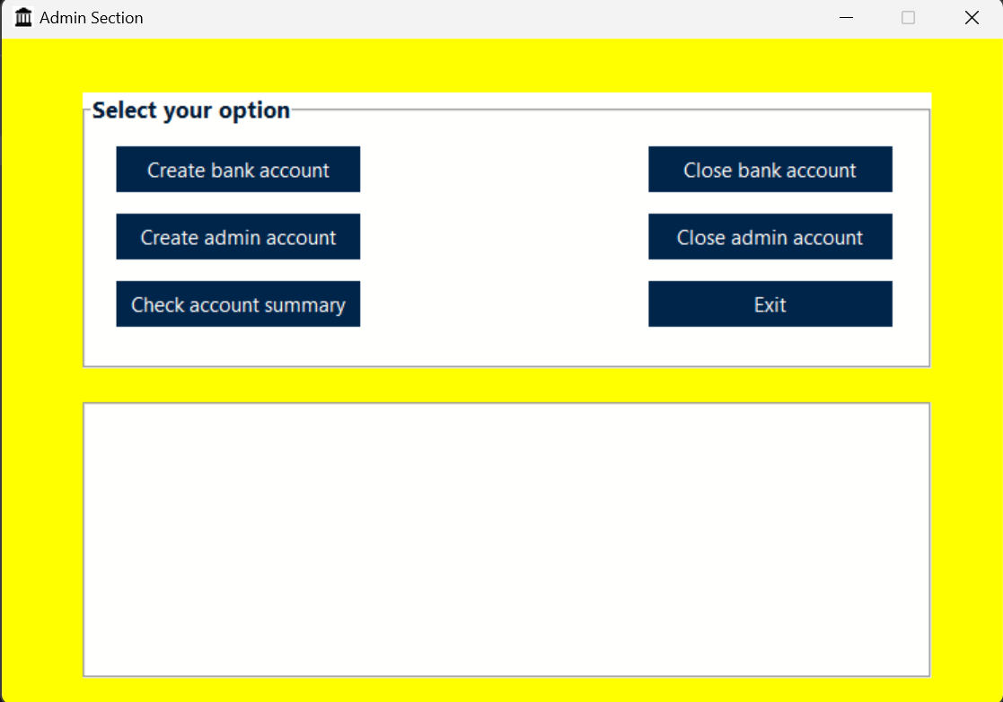
Admin dashboard
Customer dashboard

Slide 12
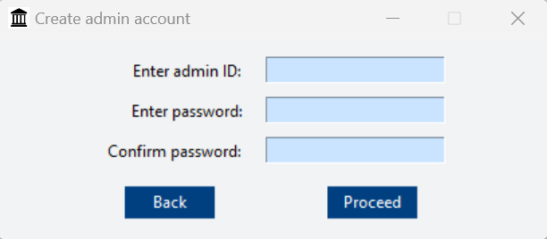
New user account
Admin checking account summary
New admin account

Slide 13
Result
The Bank Management System in Python using Tkinter is a software application designed to streamline and manage banking operations through a user-friendly graphical interface. Developed using the Python programming language and Tkinter library for the GUI, this system offers a range of features for efficient bank management. Users can perform essential banking operations such as creating, reading, updating, and deleting records, along with robust user authentication and authorization mechanisms.

Slide 14
Thank you ☺

